Slide 1
Procedures & Arguments Part 1
Visual Basic

Slide 2
Table OF contents
Lecture context
Variables
Subroutines
Passing Arguments By Value
Passing Arguments By Reference

Slide 3

Lecture context
Most non-superficial programs are very large, with 1000s of lines of code and 100/1000s of variables.
Programmers need a way to encapsulate portions of a program to develop and test in isolation from the rest of the code.
It is also important to re-use resources (memory) and control the scope of variables to ensure one does not accidentally change values in other sections of code.
Much code is written by teams and an individual’s section of code also needs to easily integrate into the overall program without modification or issues.
Procedures, such as Sub Routines facilitate all this.

Slide 4
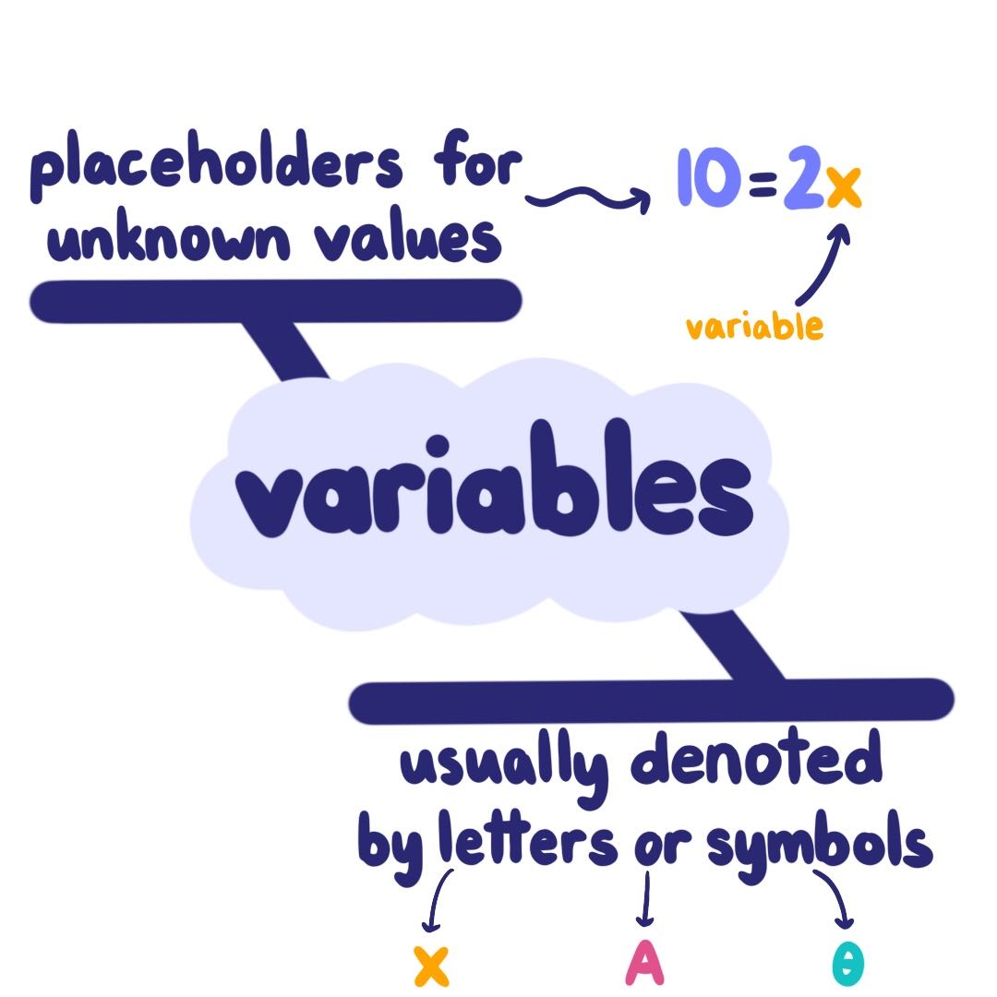
Variables
Create variables (use memory) when needed + destroy (release memory) when not
Manage by grouping and limiting their Scope to Procedure Level
Global variables only used if no other way to share data across modules - never passed!
Procedures should operate only on Private objects / data passed to them

Slide 5
SUBROUTINES
Code within Sub/End Sub statements
private sub name (inputs)
End Sub passes control back to calling program: line after the call is then run
Private Sub DisplayCount()
intCount = intCount +1
txtDisplay.text = intCount
End Sub

Slide 6
SUBROUTINES
Invocation by name: Call DisplayCount
May pass data into Sub using brackets with ‘Call’ or none without Call command
Call FindSum(23, 34) or FindSum 23, 34
Event handlers are Subs - may be called
Program flow immediately diverted to sub
‘End Sub’ returns program flow to line following the call in original routine
In standard module use Public sub name()
Private Sub DisplayCount()
intCount = intCount +1
txtDisplay.text = intCount
End Sub

Slide 7
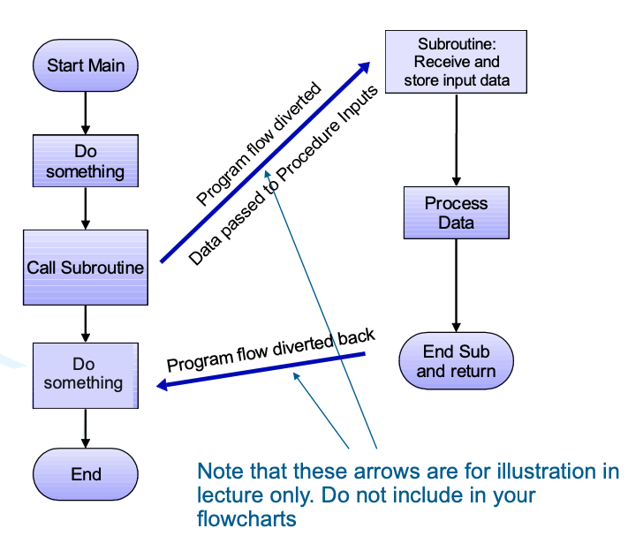
How does a subroutine work ?

Slide 8
Passing ARGUMENTS BY VALUE
Arguments usually = data (constant or variable)
Passes data values to procedure but does not give the procedure access to their address
Procedure gets copy of original variable contents
If the procedure changes the value, the change affects only the copy and not the variable itself
Use the ByVal keyword to indicate an argument passed ‘by value’

Slide 9
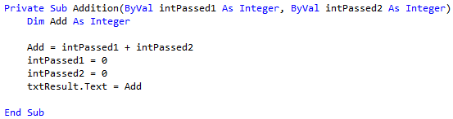
Passing by value example
This Subroutine receives copies of two DATA with no link to original data
These receive and store data for processing
Input variables declared in the brackets

Slide 10

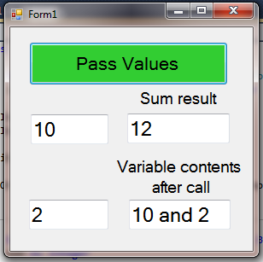
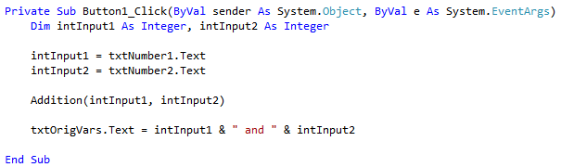
Passing by value example
Passes copy of CONTENTS of intInput1 & intInput 2
After run: intSum = 12 , intInput1 = 10, intInput2 = 2
NOTE No change made to original variables’ contents from inside the calling procedure, only changes are to those variables within the Sub

Slide 11
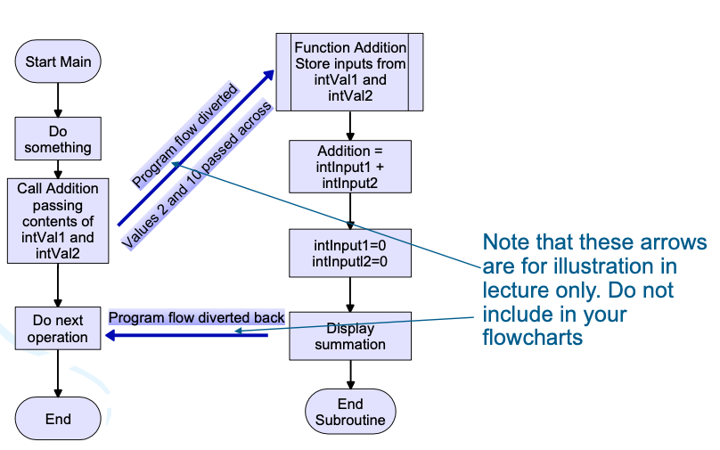
By value flow illustration

Slide 12
Passing ARGUMENTS BY Reference
An invoked Procedure given access to original variable’s address in RAM: link to the address
Any changes made to passed argument in the invoked procedure affects the original variable contents too
Data type for an argument passed by reference must match type in the Procedure declaration
Good practice to use different names for data in sending procedure and receiving procedure

Slide 13
Passing by value example
This Subroutine receives copies of two DATA with no link to original data
These receive and store data for processing
Input variables declared in the brackets

Slide 14
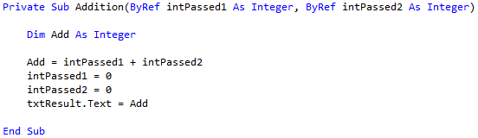
Passing ARGUMENTS BY Reference
This Subroutine receives reference to two ADDRESSES = links to original data
Any changes made to passed argument in the invoked procedure affects the original variable contents too
Data type for an argument passed by reference must match type in the Procedure declaration
Good practice to use different names for data in sending procedure and receiving procedure
put variables declared ByRef which is the only change to the previous ByVal program

Slide 15
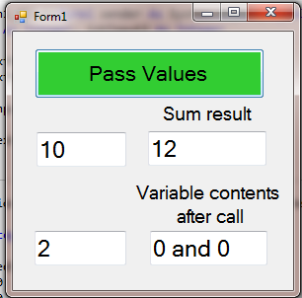

Passing ARGUMENTS BY Reference
Passes ADDRESSES of intInput1 & intInput2
After run: intSum = 12, intInput1 = 0, intInput2 = 0
NOTE original variables’ contents were set to ZERO by the sub routine’s code setting its local variables to zero because of the addresses being passed

